Slide 1
MIMIC-IV Clinical Database
Presentation
Roxanne Dimadi, Ian Chang, Daniel Yan, Owen Guo, Juan Pablo Reyes Martinez, Henry Shi
05/2026
Notes:
Ian

Slide 2
Presentation
overview
Dataset Description
Dataset summary / likely audience
Use Cases
Data governance
Schema Design
Relational model
NoSQL
Queries
Logical Plan
Indices / caching structures
Notes:
Ian

Slide 3
The Dataset
Developed by MIT, the MIMIC dataset is an anonymized database of real patient records from intensive care units. It was created to bypass strict medical privacy laws that usually make medical data inaccessible.
Notes:
Ian

Slide 4
Dataset Summary
- The demo represents a subset of 100 patients, but it preserves the full schema and relationships of MIMIC-IV
- Total demo dataset size is currently 15.5mb with 26 total tables, available
in csv and BigQuery, we scaled down to 7 core tables
- Likely audience: researchers and professionals who need to develop predictive models and run statistical tests on real-world clinical data.
- Typical workflow: extracting specific patient cohorts using SQL queries, cleaning the sparse data in Python or R, and then train machine learning algorithms to predict outcomes such as ICU readmission or patient mortality.
Notes:
Ian
Make sure to mention something about likely audience and their technical capabilities here
For clinicians/nurses/doctors, etc. likely little to no technical skills so we’d in theory build a front-end with pre-written queries for common queries (see our use cases)

Slide 5
(Skip slide) Extra Dataset Context
While this demo MIMIC-IV dataset is mostly static, with updated versions every few years (same with the full dataset), we wanted to treat it in part like what it’s meant to mimic: a real active hospital
This is reflected in our use cases
As such, our audience also extends from researchers to clinicians/nurses/doctors, etc. with little to no technical skills so we’d in theory build a front-end with pre-written queries for common demands (e.g. see use cases)
Notes:
Ian
Make sure to mention something about likely audience and their technical capabilities here
For clinicians/nurses/doctors, etc. likely little to no technical skills so we’d in theory build a front-end with pre-written queries for common queries (see our use cases)

Slide 6
Anonymization
Attributes
Scale & Growth
Dataset Description
Anonymizing Identifiers
Obscuring Timelines
Data Scrubbing
All Protected Health Information (PHI) was removed to meet HIPAA standards
Sensitive patient and hospital IDs were replaced with random numbers.
All chronological data was systematically shifted by random scalar values. This obscures precise years, seasonality, and days of the week, while preserving the mathematical time intervals between clinical events.
The dataset removed all personal patient information using: automated rules to catch obvious identifiers, algorithms to catch trickier ones in written notes, and a final human check.
MMIC is updated every few years, but real world database grows exponentially every hour
Every record does not need an attribute (Ex: every patient doesn’t need a prescription)
Attributes vary in types
patients
subject_id
gender
anchor_age
admissions
hadm_id
admittime
insurance
admission_type
icustays
stay_id
first_careunit
los
outime
prescription
drug
route
drug_type
drug_val_rx
Notes:
Roxy
PHI is removed to meet HIPAA standards, Sensitive patient data like birthdays,
As a research tool, the MIMIC dataset is updated in large historical batches every few years by MIT rather than continuously.
However, the real-world clinical databases it represents grow exponentially and rapidly, adding thousands of new data points per hour for every patient connected to intensive care monitors.

Slide 7
Use Cases
These four use cases reuse core identifiers (`subject_id`, `hadm_id`, `stay_id`) and rely on a compact set of event, dictionary, and flow tables. This keeps the schema manageable while still enabling medication safety, ICU risk analysis, utilization planning, and flow optimization.
Utilization & discharge planning by demographics Moderate frequency — periodic reporting
ICU Early Warning and Length-of-Stay Prediction - Ad hoc (research) → extreme volume if live
Hospital flow & transfer bottlenecks - Moderate frequency — operational reviews
Medication Administration Safety and Reconciliation - HIGH FREQUENCY
Goal:
Use early ICU vitals and labs to flag patients at risk of prolonged stays
Outputs:
Risk tier labels (short / medium / prolonged); early warning indicator thresholds
Example Analysis:
ICU length of stay prediction
Goal:
Explain how demographics and admission context relate to utilization patterns and discharge outcomes
Outputs:
Utilization report by payer and age group; discharge destination breakdown with ICU exposure
Tables:
patients, admissions, icustays, services, transfers
Goal:
Identify unit-level bottlenecks and delays in patient movement
Outputs:
Flow map of transitions (ED → ICU → floor); bottleneck report by care unit and service
Tables:
admissions, transfers, services, icustays
Goals
Catch dose mismatches, omissions, and administration delays
Outputs:
Safety dashboard per patient; high-risk medication list
Tables:
emar, emar_detail, prescriptions, admissions, patients
Evolution
Currently ad hoc for research and model development. If deployed clinically, patients generate thousands of data points per hour — queries shift from batch analysis to a continuous live warning system, demanding real-time pipeline infrastructure.
Evolution
Begins as retrospective operational reviews. With live data, flow maps become real-time bed management tools — shifting from weekly reporting toward continuous capacity monitoring and automated bottleneck alerts.
Evolution
Starts as ad hoc audits → becomes standing shift dashboards → expands to predictive flagging as more data sources (labs, vitals) are added. Higher adoption will require precomputed aggregates for performance.
Evolution
Starts as periodic operational reports. As the application grows, demographic breakdowns may feed into equity monitoring programs or payer negotiations — increasing both the sensitivity of the data and the need for consistent, auditable query definitions.
Notes:
JP

Slide 8
Data Governance

Slide 9

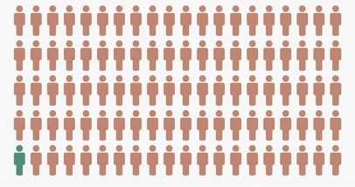
Governance Issues
Other Potential Issues
Drug prescriptions
Lab values
Patients
Admissions
Services
Age
Biological Sex
Insurance
Race
Admit Date
Clinical Services
How To Protect?
Patient IDs → Random Integers
Dates → Random offsets
Remove Specific Identifiers
Restrict Data Access
Data User Agreement
Log User Data
Age + Sex + Race + Insurance + Admit Date + Clinical Services = 👤
Re-use Issues
Re-identification: People can re-identify individuals combining data
Time Validity: Medical practices change over time, this data from 2011-16 may not accurately model today’s patients or even ICU practices
Scope Expansion: Data was approved for research purposes only
Notes:
Roxy
Some sensitive information in these main tables can be age and sex for patients, insurance, race, and admit date for the insurance table, and the type of service which can easily be traced back to the patient
The dataset protects this sensitive information by [how to protect slide] , but even after these data privacy effort, there’s still some issues [other potential issue slide]
Some issues in reusing this dataset are [re use]

Slide 10
Schema Design

Slide 11
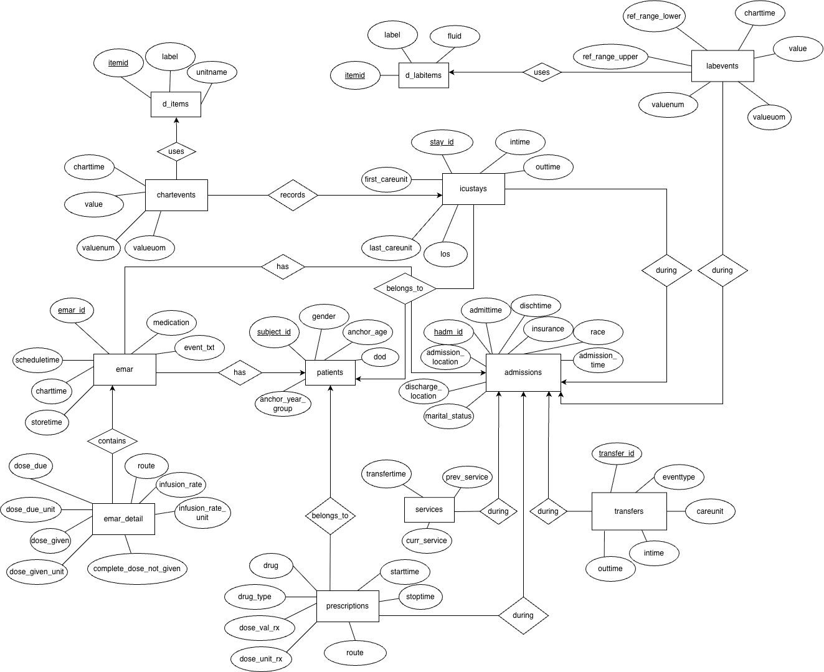
Relational Model: ER Diagram
Partitioning
The dataset can exceed 2TB
Justification: MMIC-IV’s full dataset can generate hundreds of thousands or rows
ex: ICU patient generating vitals
Consistency trumps availability, RDBMS
Data needs to be as accurate as possible when dealing with medications and health data
Partitioned RDBMS preservers full ACID within each shard (medication administration is either full written or not at all)
NoSQL systems are eventually consistent, which for an early warning system is a safety risk
Partition key: subject_id and patient’s records live on same node
Joins across network have huge cost, but not very applicable with our use cases (medication safety and ICU warning, both high frequency)
Long stay patients can become hot spots
Notes:
Owen
MIMIC-IV will exceed 2TB due to high-frequency clinical event tables — a single long-stay ICU patient can generate hundreds of thousands of rows in chartevents and emar alone.
We chose a partitioned RDBMS over NoSQL because consistency is a patient safety requirement here — eventual consistency on a medication dashboard isn't acceptable.
Our partition key is subject_id. Our two highest-frequency use cases — medication safety and ICU early warning — are both patient-centric, so partitioning by subject_id means those queries never cross a shard boundary. Our lower-frequency analytical use cases will scan all shards, but that cost is acceptable given how rarely they run.
Even though joins across servers may have huge network IO cost, this isn’t applicable to our specific use cases. Our dominant queries (medication safety and ICU warning) are patient-centric. If we partition by subject_id, a clinician pulling patient 42's full record, ie medications, vitals, labs, admissions will live on one node
One limitation: long-stay ICU patients could become hot spots, which we'd address with a composite subject_id and time bucket key if needed.

Slide 12
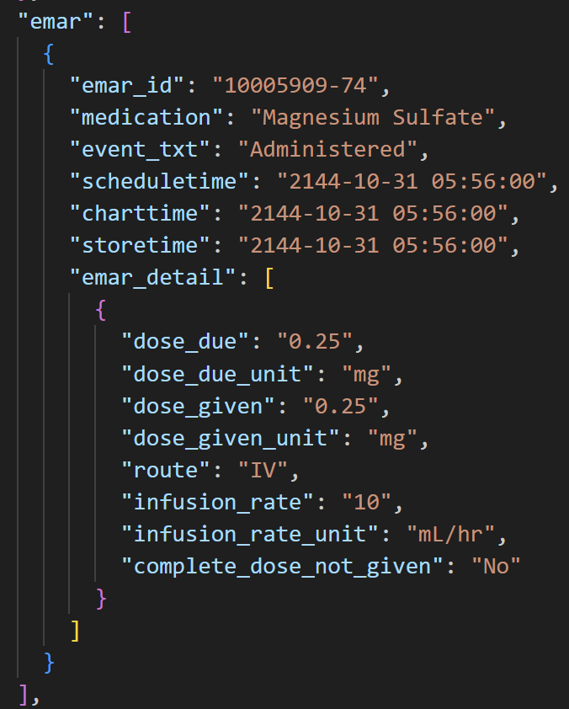
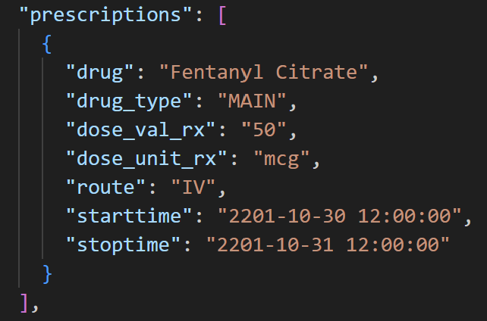
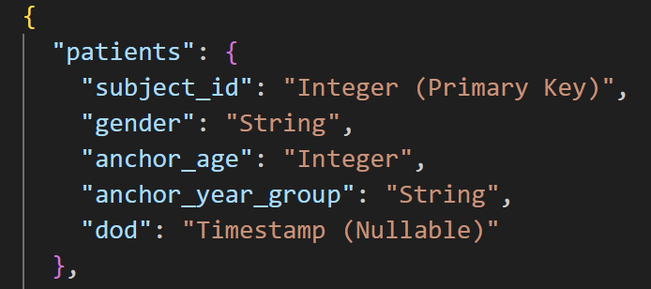
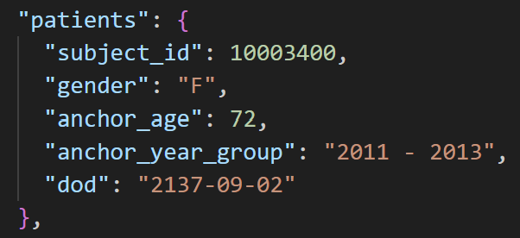
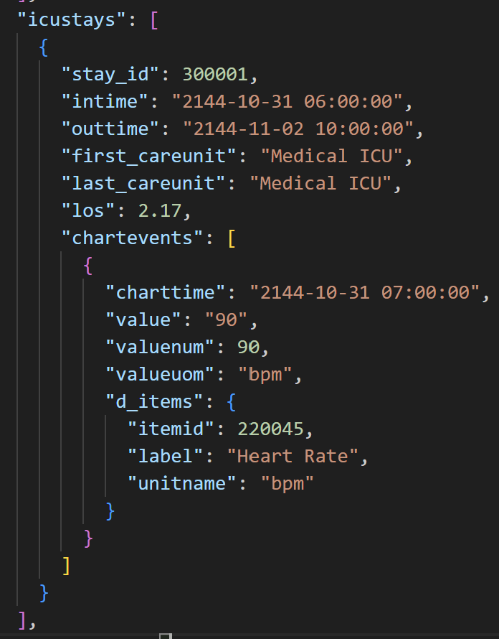
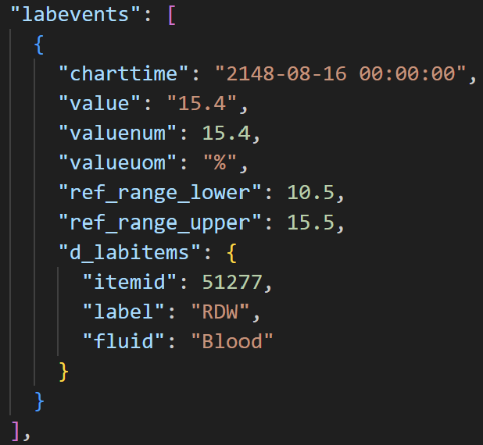
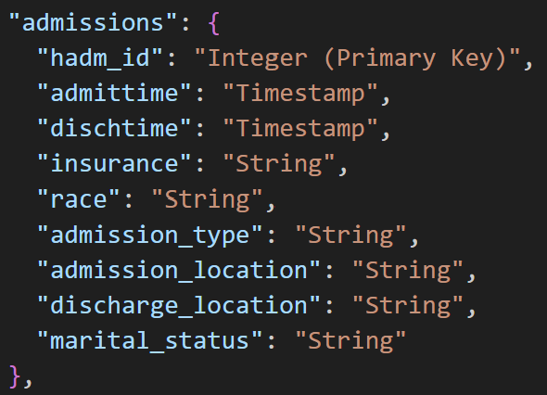
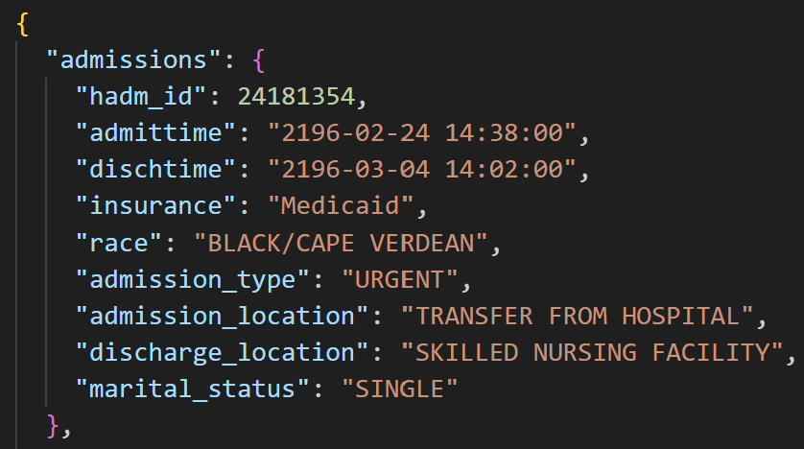
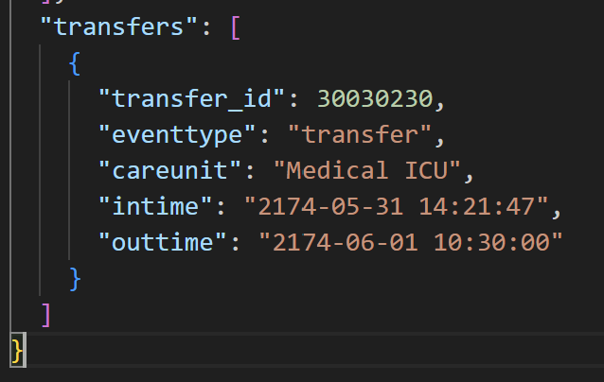
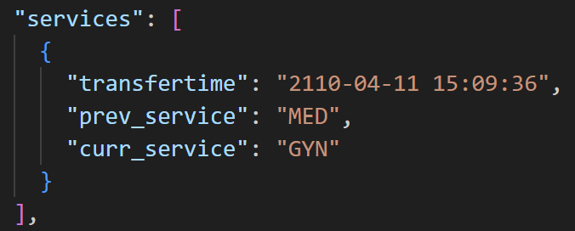
NoSQL Model: Document Database
Core Patient & Hospital Flow
Notes:
Owen

Slide 13
Queries

Slide 14
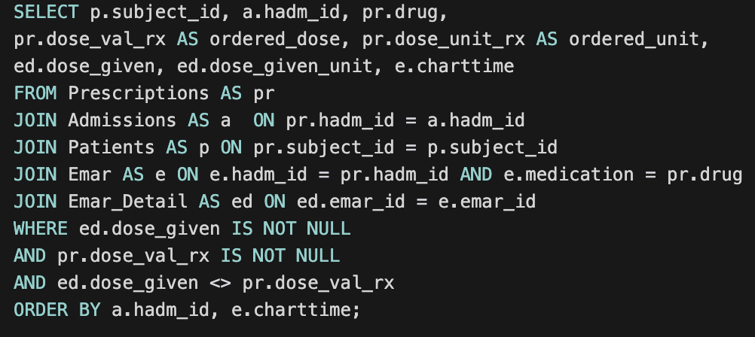
Dose Deviation Deduction
Example Query 1
Use Case: Identify and rectify issues with under/over dosing
Or check for issues even before EOD procedures
Frequency: Runs automated daily for operational analysis procedures
Can also be requested on-demand by staff
Output:
List of all anomalies between ordered and administered medications that are charted.
Relational Schema
NoSQL Schema
The NoSQL traversal from our schema would iterate the admissions array within each file, looking for pairs of prescription.drug = emar.medication and emar.hamd_id = prescription.hamd_id for each hamd_id.
From there, for each match it would check the emar entries and checks emar_detail.dose_given and prescription.dose_val_rx being not null and if all conditions are fulfilled, spits out all the values that it checked along with dose_given_unit and charttime.
Notes:
Daniel

Slide 15
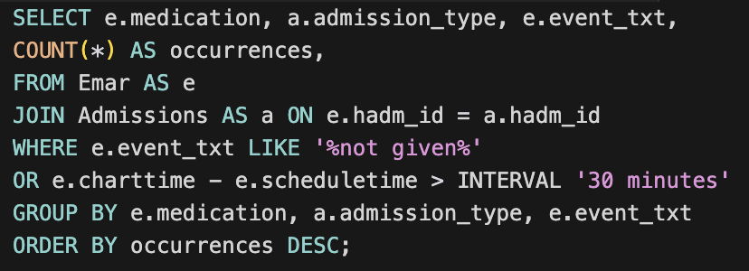
Omitted & Delayed Doses
Example Query 2
Use Case: Identify delays and omitted doses of medications, grouped by medications
Frequency: Daily or on-demand
Output:
Lists counts of all delayed & omitted doses between ordered and administered medications that are charted, grouped by medication.
Relational Schema
NoSQL Schema
Within each document it would again iterate on admissions, reading admission_type and hadm_id and then iterate through the emar arrays.
It checks the equivalent of the SQL WHERE clause and if it meets the criteria (event_txt is ‘not given’, charttime - scheduletime is greater than 30 min), it would emit the occurrences of corresponding tuples in descending order.
Notes:
Daniel

Slide 16
Logical Plan

Slide 17
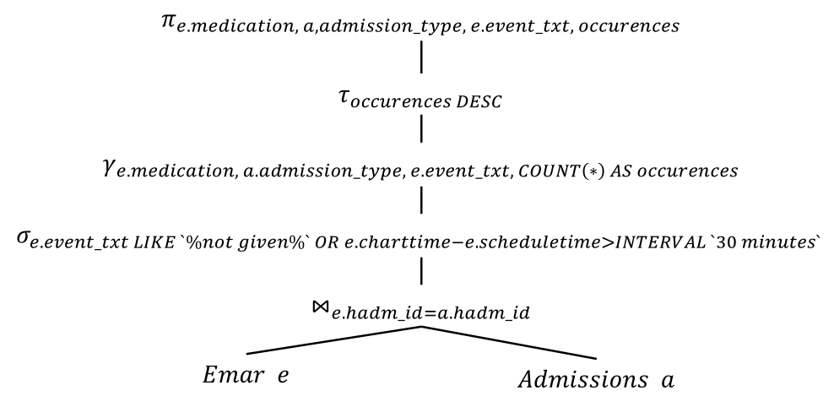
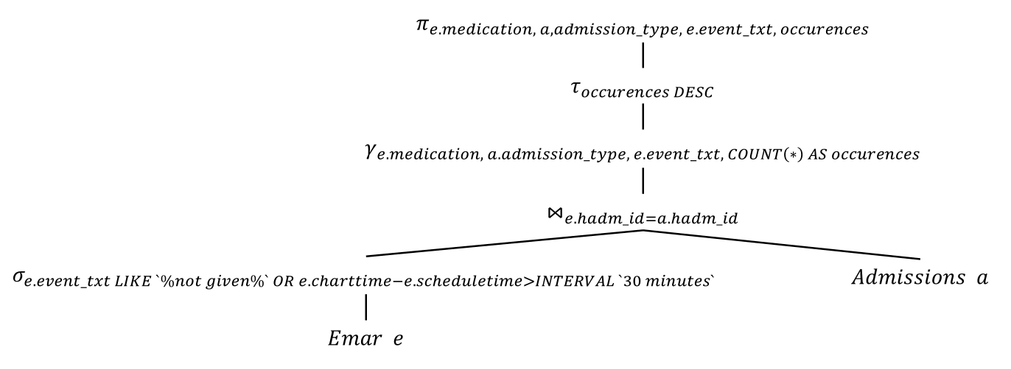
Logical Plan: Omitted & Delayed Doses
Logo
Naive RA Tree
Updated RA Tree
The updated RA tree that is presented offers processing benefits as it pushes the `WHERE` clause before the `JOIN`, eliminating the unnecessary rows before going into the join.
Notes:
Daniel

Slide 18
Logical Plan: Omitted & Delayed Doses (NoSQL)
Logo
Reads: emar and admissions parts of each patient document
Writes: None
Concurrency Issue: If the query runs while a patient record is being updated, it could fail to appear in the aggregation depending on if the document scan has reached the specific document or not.
Not an issue for this use case since for analytics, a few missing values in the total aggregations shouldn’t skew the conclusions in a meaningful way.
Notes:
Daniel

Slide 19
Indices / Caching Structure

Slide 20
Relational Schema
Default PK Indices: (subject_id, hadm_id, stay_id, emar_id, itemid transfer_id)
Sufficient for simple lookups / joins on PKs
Some of our use cases deal with time-range filtering on multiple non-PK columns
Indices could significantly help improve query performance, but *could also add to write times for our database*
Use Case 1
Rationale
Proposed new index
Performance Impact
Other potential PKs
Catching missing doses
Emar
(hadm_id, event_txt)
Query filters on event_txt and groups on hadm_id.
This means a full scan of emar when no index exists
New Index:
(hadm_id, event_txt)
A composite index on (hadm_id, event_txt) allows planner to seek specific records and immediately filter on status, avoiding full scan and improving runtime
Heavy improvement on efficiency of read
Use Cases 2-4 → neutral
Use Case 1:
Emar write frequency quite high but bound
Emar read frequency is comparably high because used actively by nurses and doctors
Safety critical query
For Use Cases 3 & 4
Joins are primarily FK→PK
patients.id → admissions.subject_id
admissions → icustays, transfers, services (on hadm_id)
Direct key lookups
Small/Medium tables
Default PK joins should suffice
Remaining filters (grouping) on small sets
Note:
emar = medication records
hadm_id = hospital admission ID
event_text = includes notes such as “not given”.
Notes:
Henry
Hadm_id = hospital admission ID
Emar = medication records

Slide 21
NoSQL Schema
Proposed Modification
Use Case
Modified Schema
Performance Impact
Other Use Cases
Add pre-computed dose_mismatch boolean to emar_detail at write time
When nurse / staff records medication, both dose_due and dose_given are immediately available. Dose_mismatch flag will also be computed immediately.
"emar_detail": [
{
"dose_due": "0.25",
"dose_due_unit": "mg",
"dose_given": "0.25",
"dose_given_unit": "mg",
"route": "IV",
"infusion_rate": "10",
"infusion_rate_unit": "mL/hr",
"dose_mismatch": false,
"complete_dose_not_given": "No"
}
]
Without the flag, detecting dose mismatches requires reading all of emar_detail sub-docs and computing difference between dose_due and dose_given at read.
Use Cases 2-4 → N/A
Use Case 1 write cost is minimal as it is updated as dose_given is updated
Notes:
Henry
In a document database this also enables a sparse index on dose_mismatch that only indexes true values and returns flagged records immediately without touching the full document array

Slide 22
Thank you
Questions?

